Slide 1
Linear Programming using Python and its application in fair room allocation
Under the guidance of Prof. Swaprava Nath
Submitted by Santosh Kavhar

Slide 2



Problem
Same rent for every room?
Guest Room
Bedroom
Hall

Slide 3
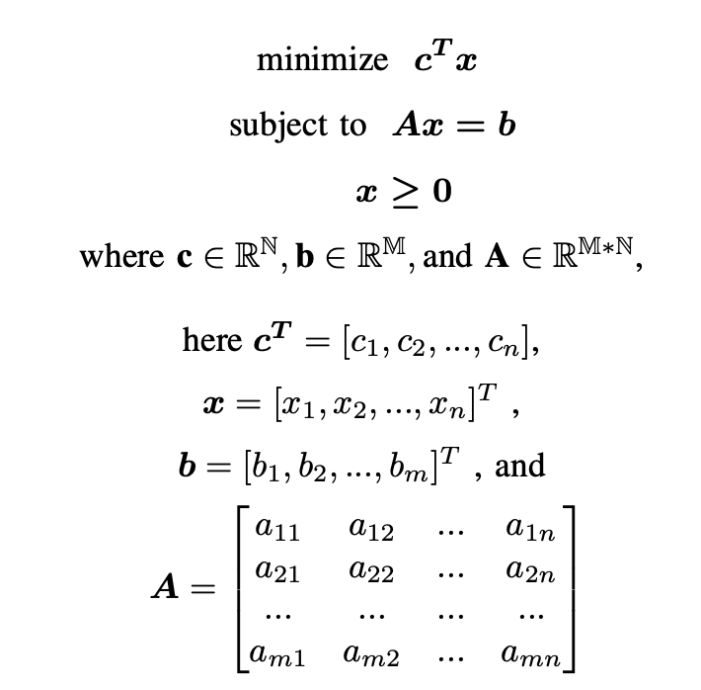
What is LP?
Linear Objective
and Linear inequalities
A method of optimising
operations with some constraints

Slide 4
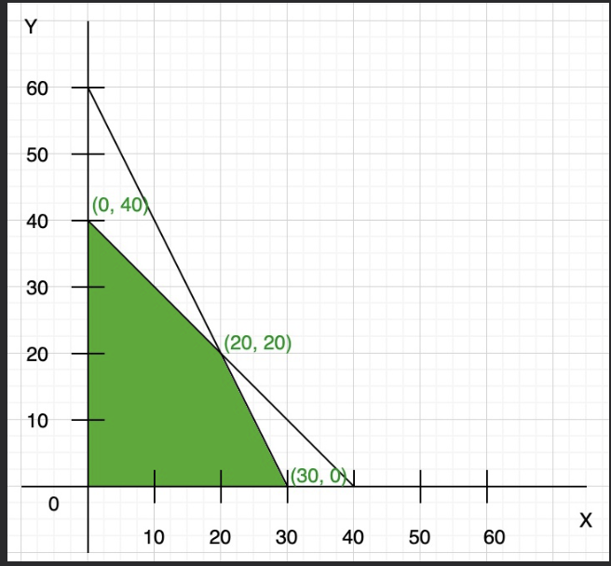
Example
Maximize: Z = 7x + y
Constraints:
x + y <= 40,
2x + y <= 60,
x >= 0, y >= 0
Max at (30, 0) -> Optimal value 210

Slide 5

What is Python?
Interpreted
Interesting
User friendly language

Slide 6
Motivation
Why this problem?
Real world
Why LP?
Used in the implementation paper
Easy and efficient
Why Python?
Strong community
Support of PuLP

Slide 7
Maximin Solution
Maximize the minimum utility each player is receiving
First step is to find Maximum Welfare Assignment
Second step is to ensure Envy-freeness

Slide 8
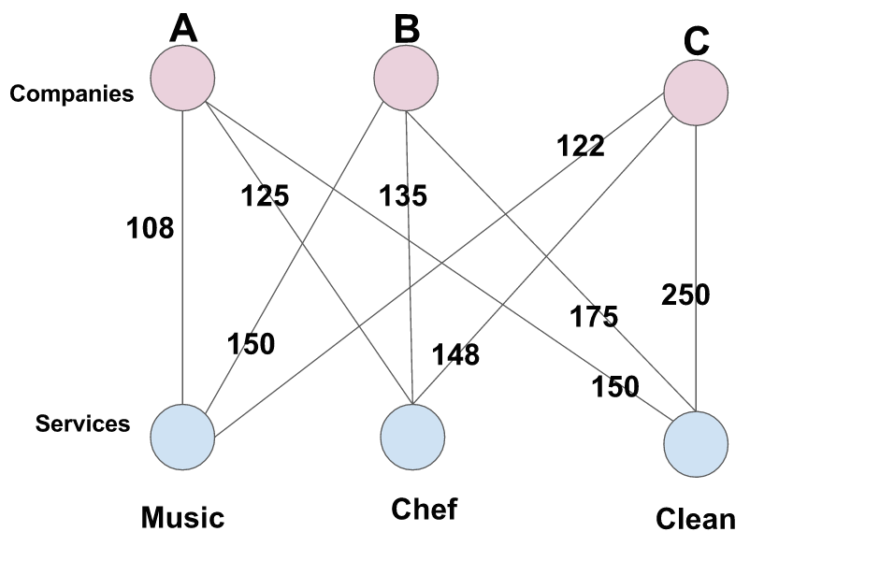
Maximum Welfare assignment
-aka Maximum Weight Bipartite Matching

Slide 9
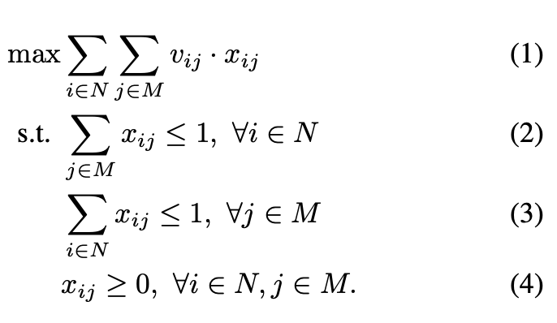
It’s Formulation
Renter i’s value for room j
x_{ij} is 1 when renter i will be assigned room j
Maximization Problem
A renter can be allotted at max one room
A room can be allotted to at max one renter
Non-
negativity constraint

Slide 10
Example
Maximum welfare assignment or MWBM
Rent per Room\ Renter | Alice | Bob | Cathy
Main Hall | 300 | 400 | 250
Bedroom | 300 | 200 | 250
Guest Room | 400 | 400 | 500

Slide 11

Envy-freeness
The profit or utility is fair for
all the players., i.e No renter
envies another renter.

Slide 12
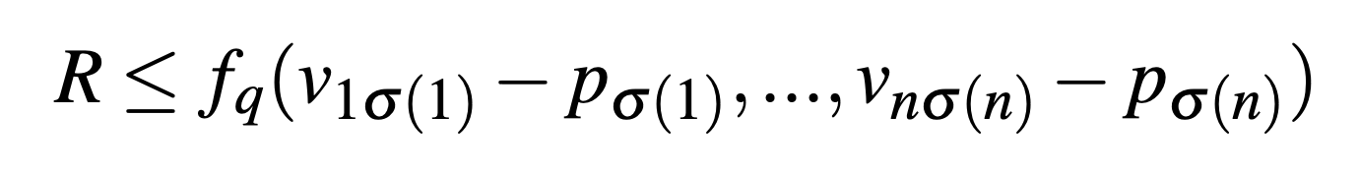
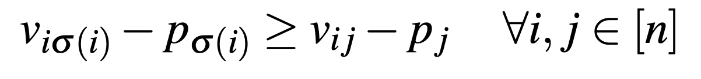
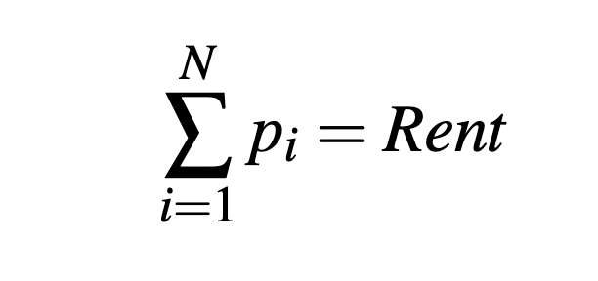
Envy-freeness formulation
Room allocated to renter 1
Room allocated to renter n
Minimization Problem:
Final price of Room j
Renter i’s value for his allocated room

Slide 13
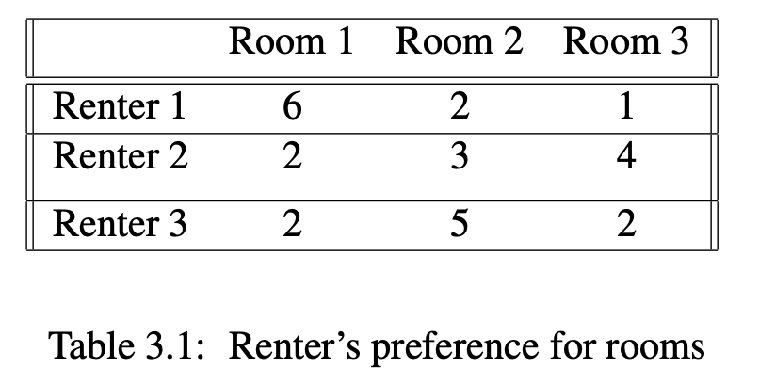
The Problem:

Slide 14
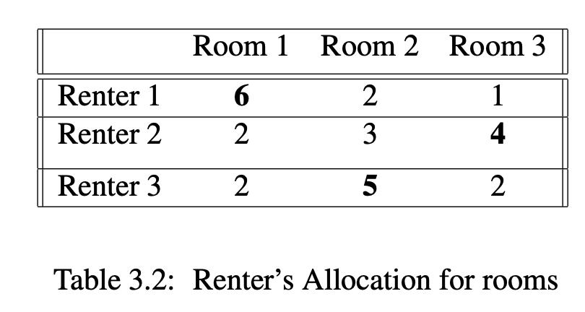
MWBM: Allocation is derived

Slide 15
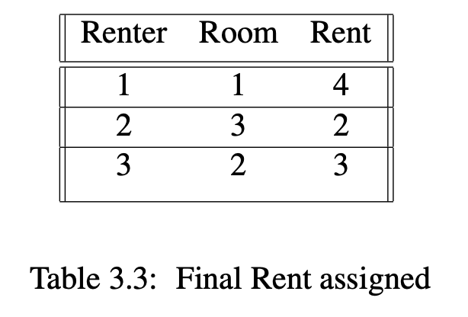
Final Maximin Solution

Slide 16
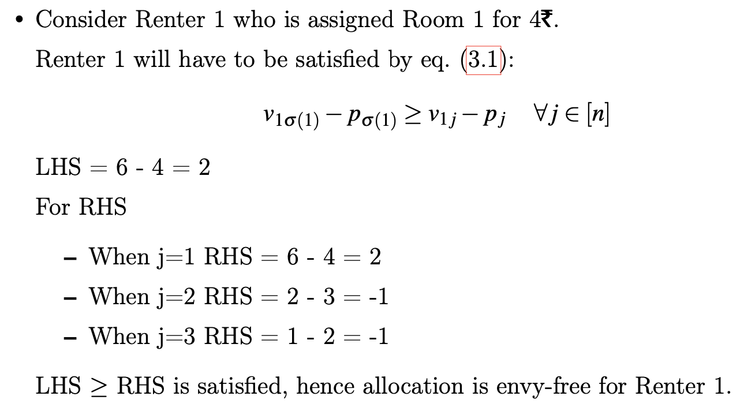
Analysis for Renter 1

Slide 17
PuLP
Variable -> x1 = LpVariable("x1", 0, None, LpInteger)
Problem -> problem = LpProblem("Room_Allocation", LpMaximize)
Optimization -> problem += 6* x1 + 4 * x2 + 7 * x3 + 5 * x4
Solve -> problem.solve() method

Slide 18
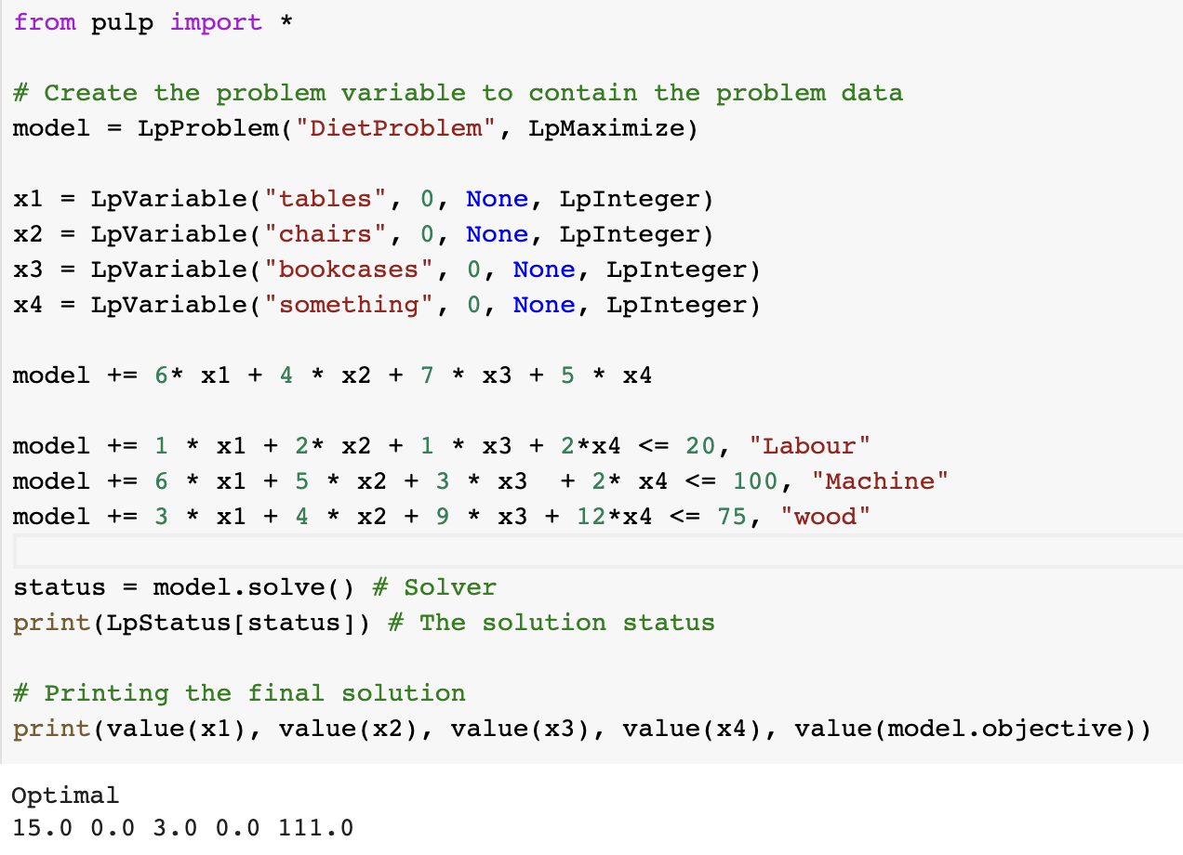
PuLP Implementation

Slide 19
Conclusions
LP to do the fair house allocation with help of PuLP library in python.
First step is to do maximum welfare assignment
Second is to ensure envy-freeness

Slide 20
Future Scope
Improve as per suggestions from guide
Implement spliddit like application for other goods as well

Slide 21
THANK YOU!!

Slide 22
References
Edwin KP Chong and Stanislaw H Zak. An introduction to optimization, volume 75. John Wiley & Sons, 2013.
Ya’akov (Kobi) Gal, Moshe Mash, Ariel D. Procaccia, and Yair Zick. Which is the fairest (rent division) of them all? In Proceedings of the 2016 ACM Conference on Economics and Computation, EC ’16, page 67–84, New York, NY, USA, 2016. Association for Computing Machinery. ISBN 9781450339360. doi: 10.1145/2940716.2940724. URL https://doi.org/10.1145/2940716.2940724.
Stuart Mitchell, Michael O Sullivan, and Iain Dunning. Pulp:a linear programming toolkit for python. The University of Auckland, Auckland, New Zealand, 65, 2011.

